Slide 1

Smart Cities
Fast Building Environment for Value Generation

Slide 2











Smart Cities: Fast Building Environment for Value Generation

Slide 3

Catalyst Goals
Smart City
Regular City
Transformation
Building Process
Enablement Platform

Slide 4
Catalyst 1st Edition – DD14
City Vision
Enablement Platform
Results and Metrics
Digital Services Catalog
Foundation Components
Building Process

Slide 5
Catalyst 1st Edition – DD14
An Platform to Enable the Fast Building Smart Cities
APPs
City Profile
Digital Services Catalog
CitySDK
Open Data
Strategy &
Planning
Solutions Portfolio
Management
&
Control
e-Participation
Assurance
Implementing
1
2
Partners Selection
3
4
API Broker
Digital Services
Enablement Platform
Results & Metrics
Reference BSI Smart-City-Standards
Enablement Platform
Fast Building Process

Slide 6
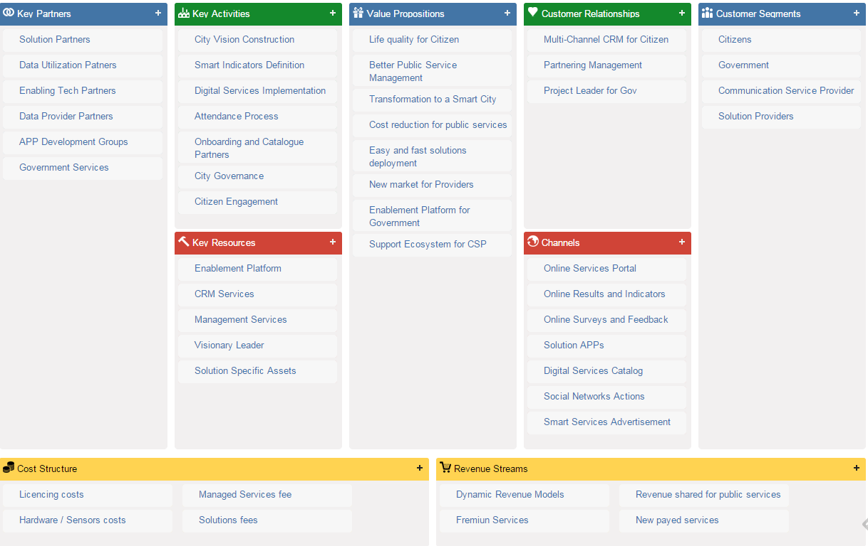
Business Model Canvas

Slide 7
Live 2015!
Catalyst Results:
The Fast Building Process
Over the
The Enablement Platform

Slide 8
The Building Process
The Step by Step Guide to Transformation
1
City Vision
2
Enablement Platform
Strategy &
Planning
Solutions Portfolio
Management
&
Control
Implementing
Partners Selection
3
Digital Services Catalog
4
Results & Metrics

Slide 9
City Vision
Step 1 – Creating the Strategy and Planning the Transformation
Government
Value Proposition Generation
+
1
Population
City Vision
+
Service Providers
Open Data Strategy
+
Solution Providers

Slide 10
City Vision
Step 1 – Value Proposition Generation
City Context Survey
Value Proposition
Actions and HowTo’s
Expected Results
Customers Information
Solution Offering
Selection
Smart Indicators
Definition
Business Model Canvas as Tool

Slide 11
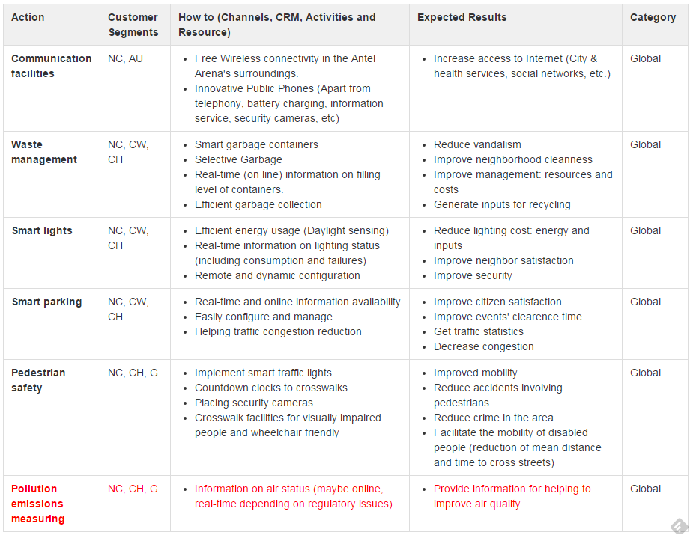
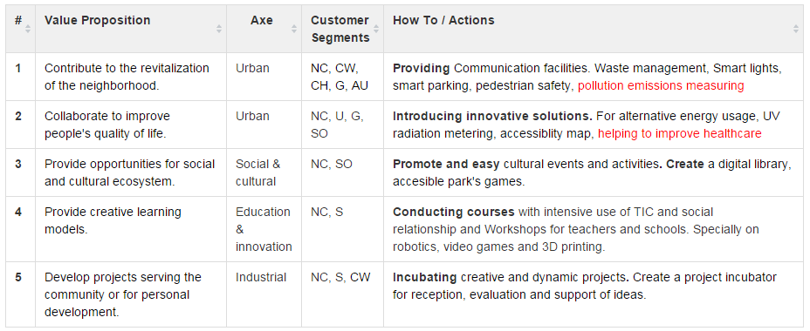
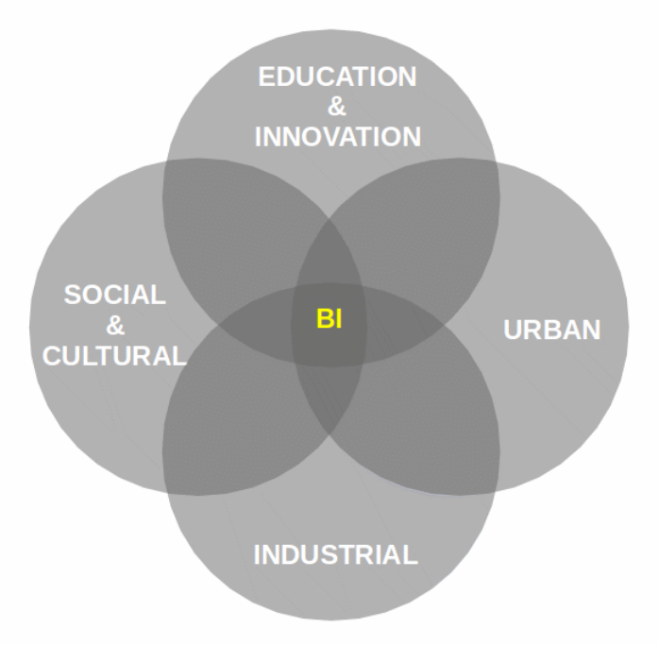
City Vision
ANTEL Innovation Neighborhood Case

Slide 12
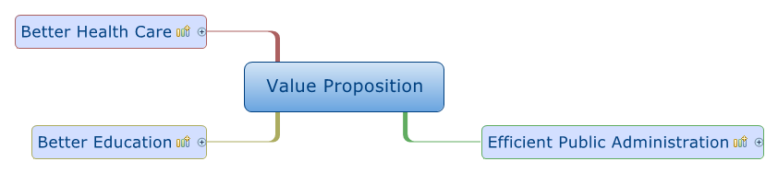
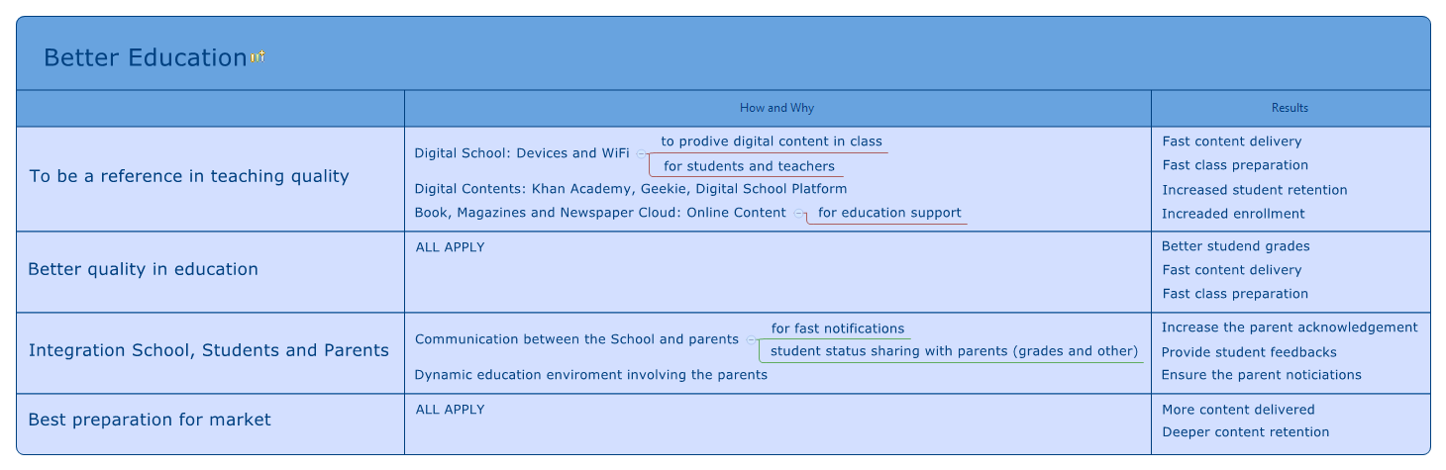
City Vision
Águas de São Pedro Case

Slide 13
City Vision
Step 1 – Open Data Strategy
Identify Data Sets
Croudsourcing
Name Sponsors
City Regulations
Open Data Sets
Promote Hackatons
Enablement Platform
Smart Indicators
Definition

Slide 14
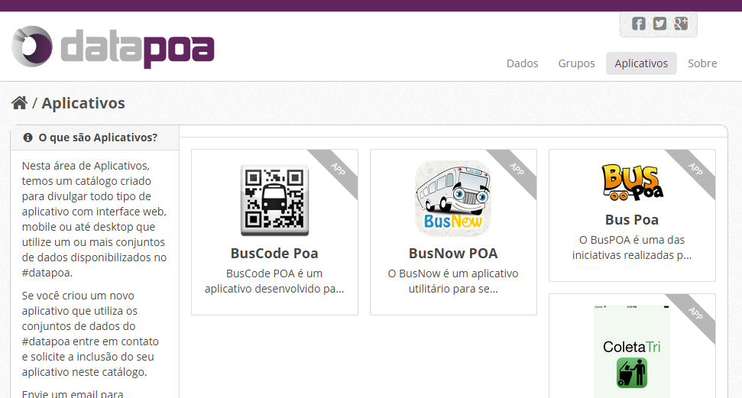
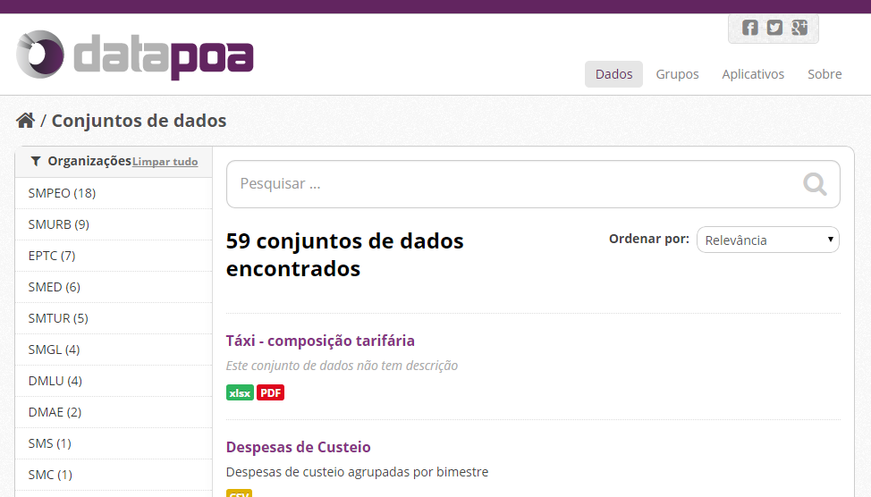
City Vision
Open Data POA Digital Case

Slide 15
Enablement Platform
Step 2 – Preparing the Smart Ecosystem
Core Capabilities
2
Enablement Platform
Digital Services Delivery
Applications Support

Slide 16
Enablement Platform
Step 2 – Platform Components
e-Participation
Applications
Assurance
Services Catalog
Data Layer
Open Data
Smart Indicators
Offering Catalog
Social Feats
Data Orchestration
P/S/R Inventory
CxM
Hotsites
Data Store
Order Mngmt
QoS Mngnt
Services Info
API Broker
Performance
City Portal
PRM Management
Digital Services
SLA Mngmt
Open311
Trouble ticket

Slide 17

Enablement Platform
Digital Services Reference Architecture Utilization
Channels / Marketplace / Store
Data Layer
Service APIs Catalog
Apps Catalog
Assurance
Service Composition/Orchestration Management
API Broker/Platform (Functional and Management API)
e-Participation
Federated Identity
Management
Federated Profile Management
Analytics
Discovery
Configuration & Activation
Assurance & Traceability
Charging
Invoicing
Catalog Lifecycle Mgmt & Federation
Onboarding
Services Catalog
Applications
Service Domain
(Public Cloud)
Service Domain
(IaaS / PaaS)
Service Domain
(Private Cloud)
Service Domain
(CaaS / NaaS)
Digital Services

Slide 18









Enablement Platform
Step 2 – Águas de São Pedro Case
APPs
Data Layer
Assurance
Digital Services
Surveilance
Smart Light
Smart Parking

Slide 19
Digital Services Catalog
Step 3 – Filling and Using the Service Catalog
Onboarding Partners
3
Digital Services Catalog
Solution Selection

Slide 20
Digital Services Catalog
Step 3 – Onboarding Partners & Products
Create Party
Agreement
Account
Final Product Offering
Product Candidate Offering
B2B Offering Subscription

Slide 21
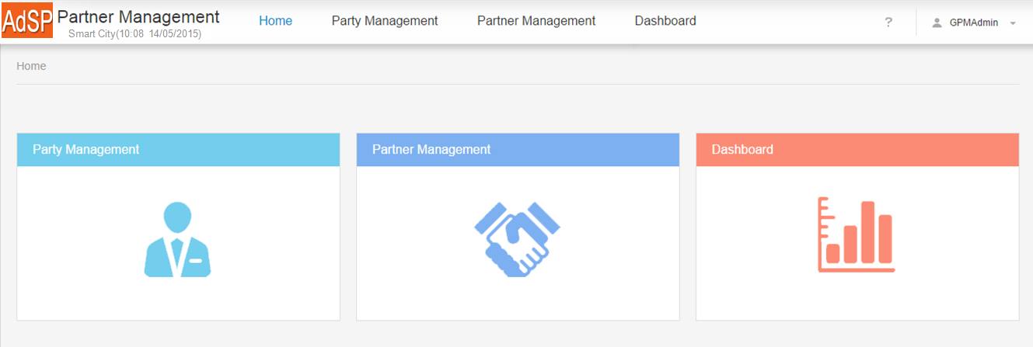
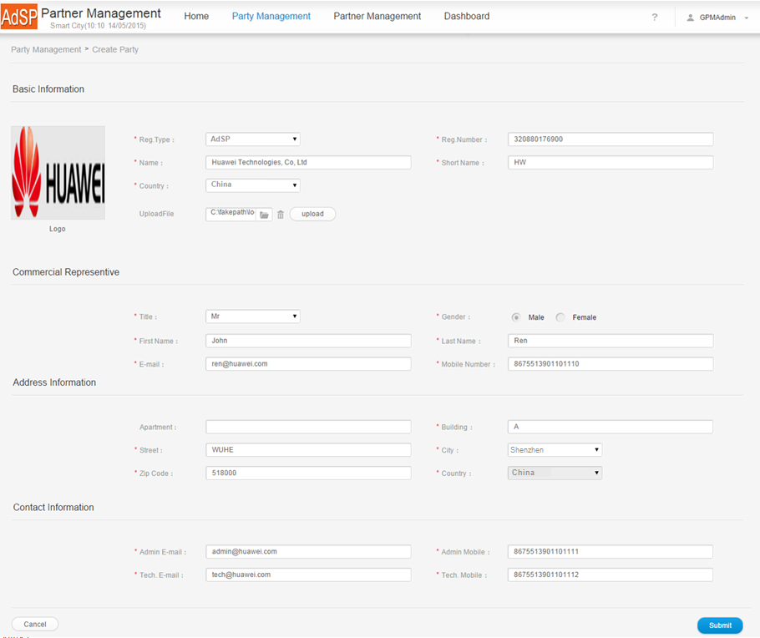
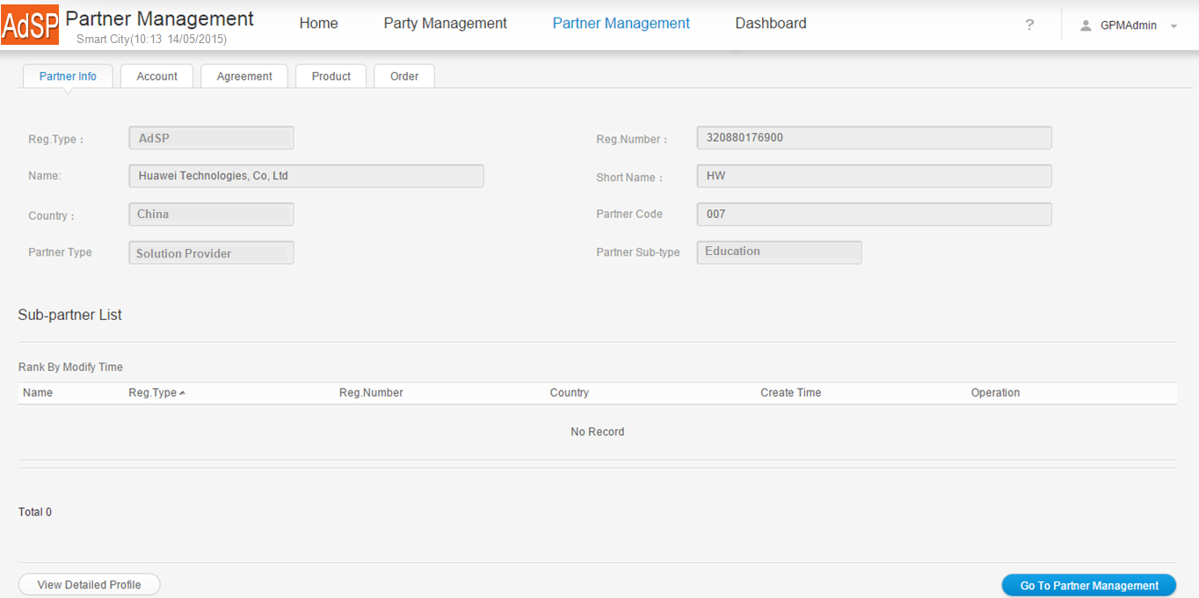
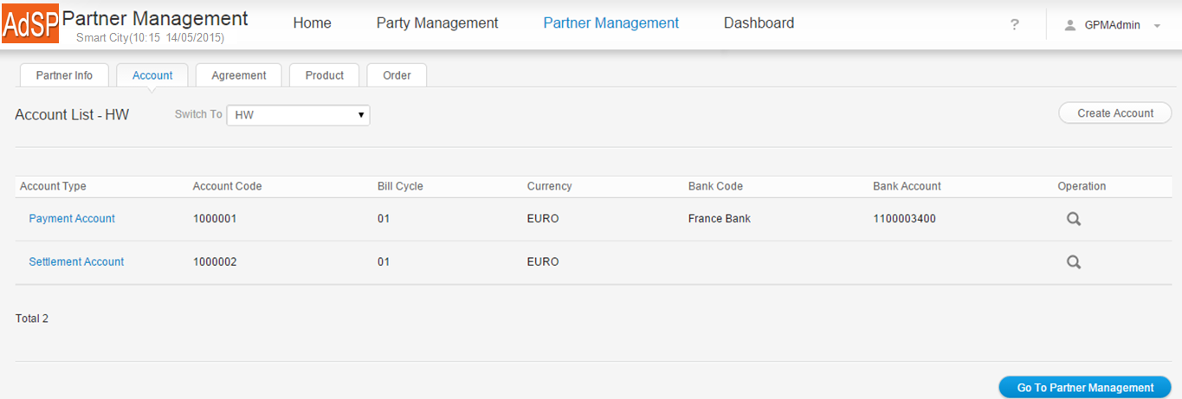
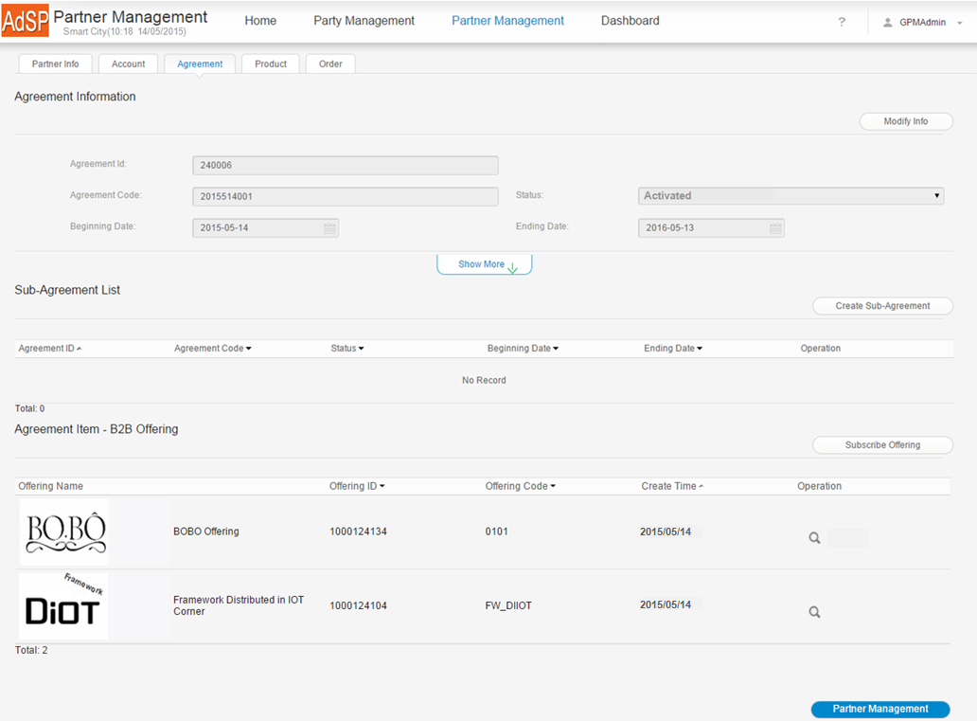
Digital Services Catalog
Step 3 – Onboarding Partners Sample Case

Slide 22
Digital Services Catalog
Step 3 – Solution Selection
Actions and HowTo
Expected Results
Solutions Definition
Tactics and Requirements
Federated Catalog Search
Products Offering Selection
Found
New Onboarding Requisition
Yes
No

Slide 23
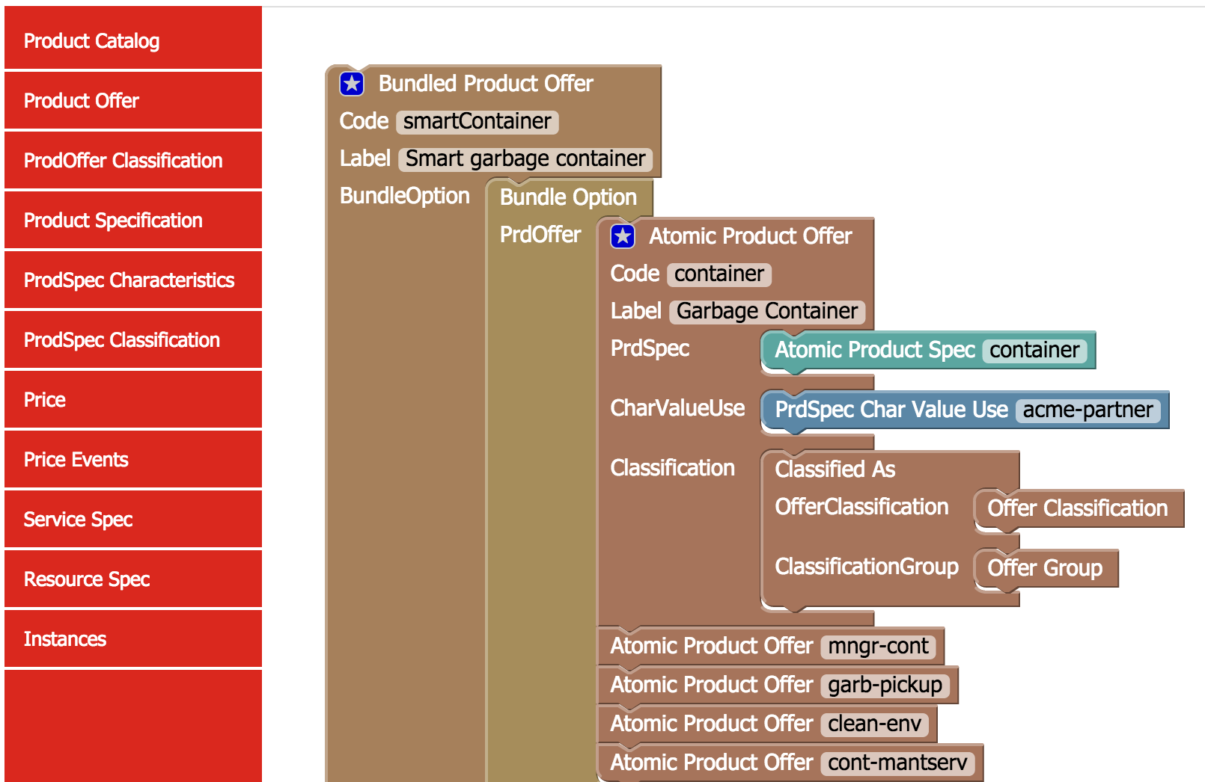
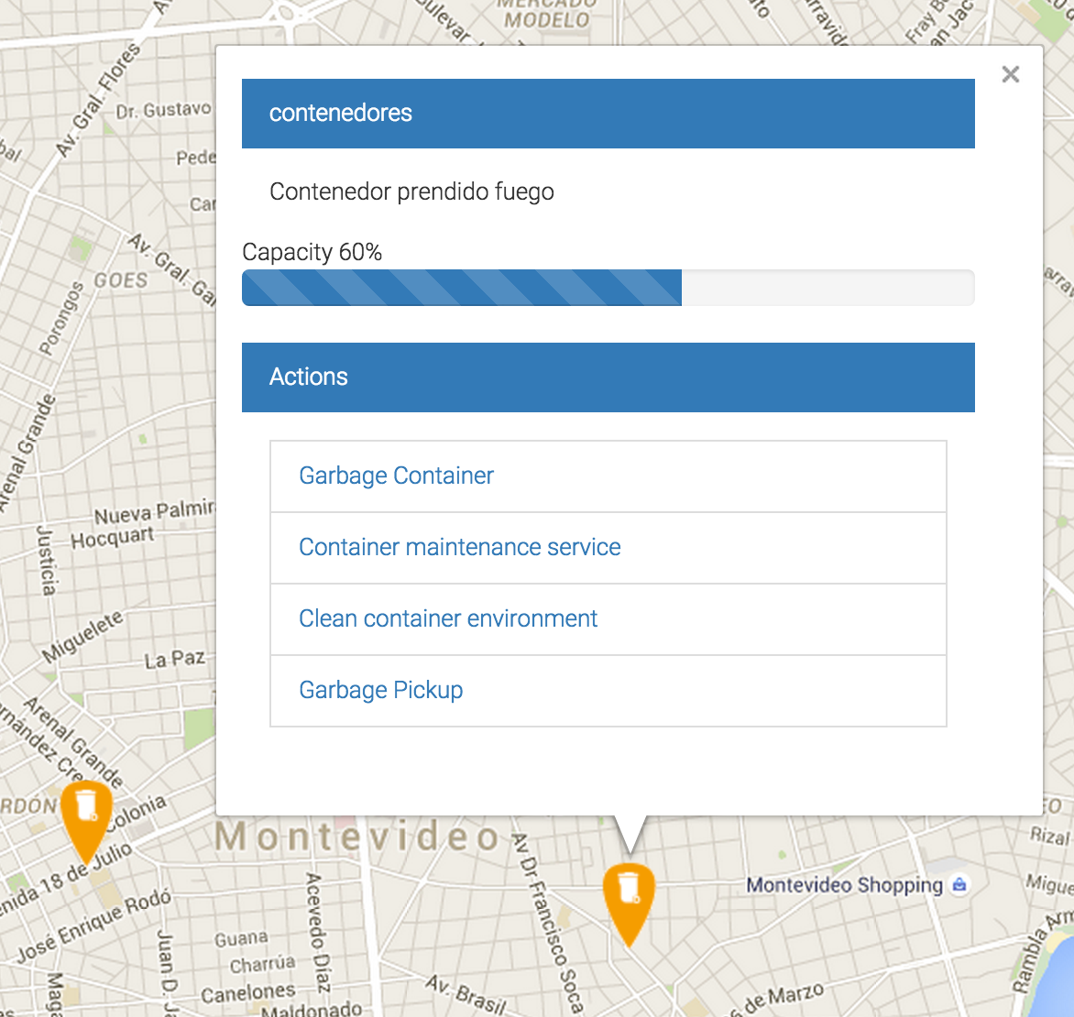
Digital Services Catalog
Step 3 – Solution Selection Sample Case

Slide 24
Results and Metrics
Step 4 – Checking the Success with Smart Indicators
Smart Indicators
4
Results and Metrics
Results Validation

Slide 25
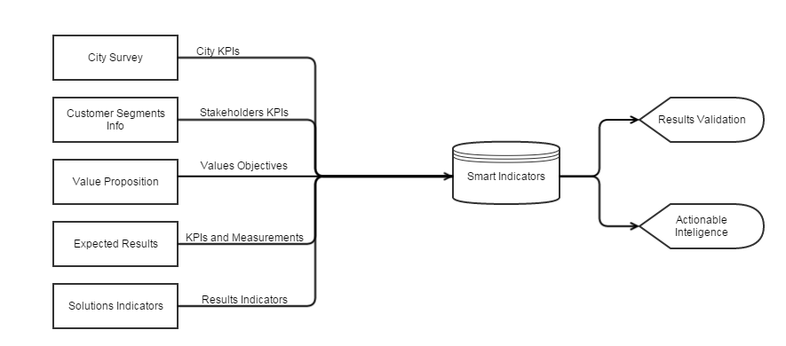
Results and Metrics
Step 4 – Smart Indicator Mapping
Adequate parking availability
Successful parking queries
High availability of parking at popular destinations and high overall utilization
High level of queries and overall utilization
Parking modifications - rate adjustments, time limits, etc.)
Query success and overall utilization rate

Slide 26
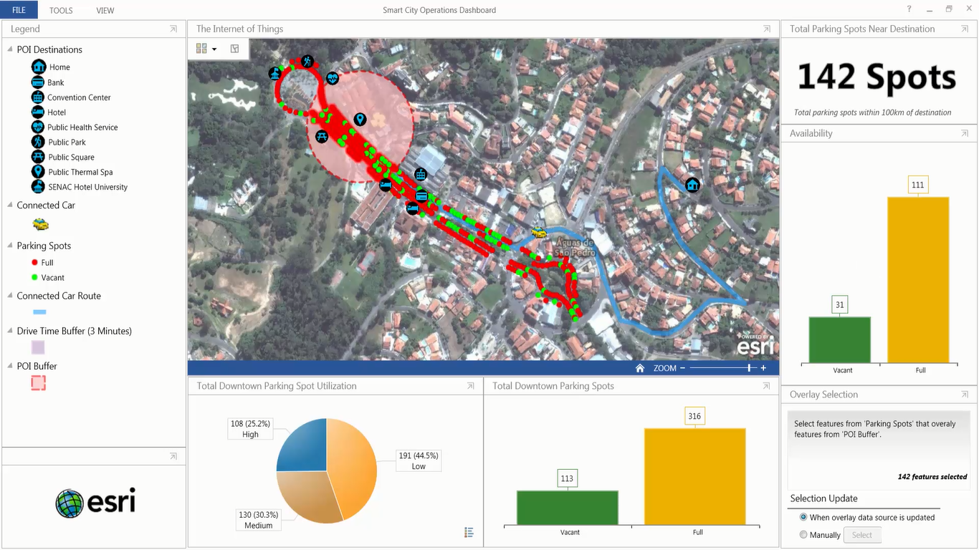
Results and Metrics
Step 4 – Smart Indicator Parking Case

Slide 27
Results and Metrics
Step 4 – Results Validation
Expected Results
City Survey
Relation
Correct
Thresholds
No
N-N
Smart Indicators
Achieved
Solutions Indicators
Yes
Maintain

Slide 28
Results and Metrics
Step 4 – Results Validation in Águas de São Pedro
Solution Indicator | City KPI | Smart Indicator | Result
#App Reports | Dengue Cases | App Reports + Dengue Cases | 80% less cases
Digital Classes | Student Grades | Digital Classes vs Regular Classes | 15% higher grades
Parking Slot Usage | Parking Time | Parking Localization | 30% fast park
Public Light Usage | Public Light Cost | Usage Measured | 20% less

Slide 29
Smart Cities Catalyst
Future Steps
Implementation Processes
Service Orchestration and Intelligence
Operational Business Process
Onboarding Process Detailing

