Slide 1






Enabling the Smart City Digital Ecosystem
“The Data Hub is at the heart
of the Smart City:
ensuring easy access to data,
empowering application developers,
and commercially enabling the Smart City ecosystem”
Use Case:
Milton Keynes, UK
Notes:
The Data Hub is at the heart of the Smart City. It’s the place that brings together the diverse range of information sources and makes them available to application developers in a standard way, enabling them to rapidly create smart city applications and analytics, to help optimise city resources and improve the lives of citizens.
We’ll show you this by using live demonstrations from our reference city of Milton Keynes in the UK, and describe how we’ve applied TM Forum know-how to help commercially enable the ecosystem.

Slide 2
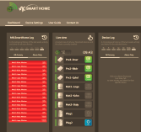
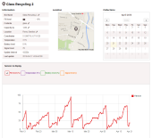











The Data Hub
End Users
Applications
APIs
Service Management
Service
Providers
Developer
Environment
Applications & Analytics
IT Services
Developers
Information Spine
APIs
Data (sensors, smart phones, historical, …)
Government
Data providers
Sensor Network Providers
Notes:
The Data can range from live information from sensors such as sensors on car parking spaces, sensors on busyness and congestion, sensors on use of energy and water, through to satellite imagery, through to information on population densities and crime statistics, through to information from people’s smart phones should they choose to share it
The data hub provides two primary services:
A set of APIs and tools is aimed at Information providers to help make it easy to bring information into the data hub
Whilst another set of API and tools is provided to Developers to enable rapid application development and to connect applications to data
An Information Spine ensures that appropriate data privacy and security is enacted.
Importantly, a Service Management environment makes this all available “As a Service” online, where commercial enablement is a key aspect…
(If questions arise on privacy/security these are best answered by showing how it’s done in the demonstration later).

Slide 3
TM Forum Catalyst Challenge:
Ecosystem Commercial Enablement
End
Customers
Virtual Service Operators (VSOs)
Sell products, services, and data
Sell packages & white label
Charging & Accounting per region/currency
Billing & Payments
Varies per council/enterprise
Commercial
Offerings
Sell Side Functions - VSO
City A Authority
City B
Authority
Enterprise 1
Enterprise 2
Wholesale
Offerings
Ecosystem Enablement Platform
BT’s CMS incorporating Bearing Point Infonova R6
Procurement Functions - VSP
Virtual Service Provider (VSP)
Aggregate commercial offerings
Set provider pricing and offers
Allocate revenue and charges
Billing & Payments
Commercial Offerings
Information Providers
Application
Providers
Application
Providers
Information Providers
Application
Providers
Service
Providers
Notes:
As well as enabling use of the data, we need to address how to monetise the data, applications, and related services, amidst a complex ecosystem- this is the primary challenge of this Catalyst project.
We achieve this using the concepts of the “Virtual Service Provider” - VSP and the “Virtual Service Operators” – VSO. This uses technology from Bearing Point called Infonova R6, which runs within BT’s Compute Management System (CMS), and is based on TM Forum standards uses approaches in the TM Forum Open Digital Ecosystem initiative.
The VSP acts as the procurement platform, buying in data and services for the Data Hub.
These are then in turn delivered to VSOs who aggregate and sell these to end customers using their own commercial offerings and pricing- which may be applications, analytics, or even white labelled data hubs using their own brand.
The Ecosystem Platform handles all the accounting, billing, cost and revenue allocations within the ecosystem- enabling the ecosystem to operate commercially
This provides tremendous commercial flexibility – where the ecosystem platform provider can enable any organisation to use Data Hub services, to contribute to Data Hub services, or to become their own commercially operable Data Hub.
The best way to understand this is to see it in action…

Slide 4

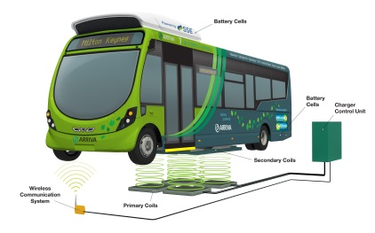













The Use Case
Milton Keynes is the UK’s fastest growing city, economy set to grow 67% by 2026
City infrastructure under strain
Target: enable growth of 20% with no net increase in water, energy, waste collection, and reduce congestion
SME incubator of up to 100 SMEs, with projects in transport, energy, water, home, and education
Notes:
Our demonstration use case is Milton Keynes, which is the fastest growing city in the UK (statement from cities outlook 2011 population growing ~20% per 10 years, whilst economy to grow by 67% by from 2013 – 2026 Oxford economics 2012 GVA £7bn-£11.5bn)
The city authorities are concerned that the transport system and energy and water infrastructure cannot sustain the rate of growth in people and businesses
So the Data Hub is being used to enable the creation of applications aimed at enabling growth with no net increase in resources
We have a choice of demonstrations to show you, depending on how detailed you wish to go…

Slide 5
Live Demonstrations
The MK Data Hub in action
  Example applications
  Use of APIs and developer tools
Commercial Enablement using Infonova R6
  Behind the scenes view of the commercial ecosystem
What’s next? - Enabling a better SLA using CloudSoft AMP
  SLA Considerations
  Dynamic allocation of Data Hub IT resources
Notes:
Firstly we can show you the Data Hub in action- some of the applications and tools for developers and information providers
Secondly we can go behind the scenes and see how the commercial enablement components work
Thirdly we can have a look at “what’s next”… where we are working on how to achieve Service Level Agreements for applications dependent on the data, and how to optimise Data Hub IT resources to serve those applications.

Slide 6

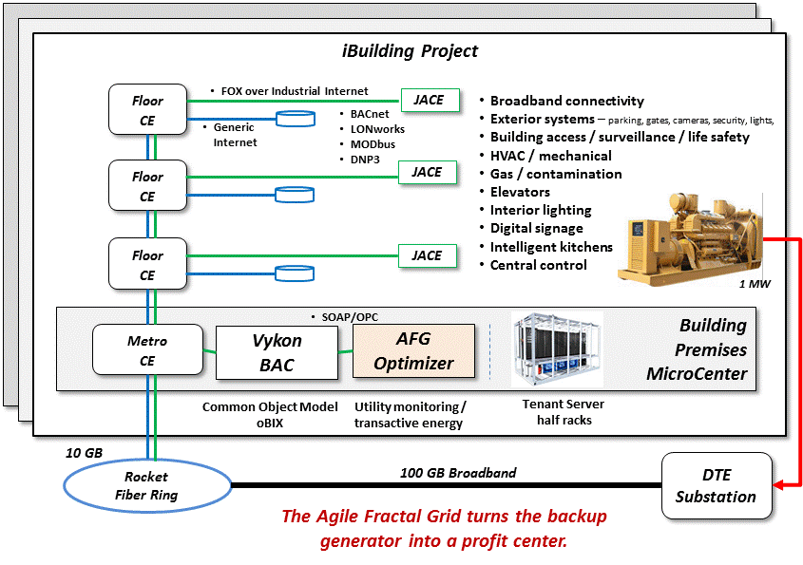
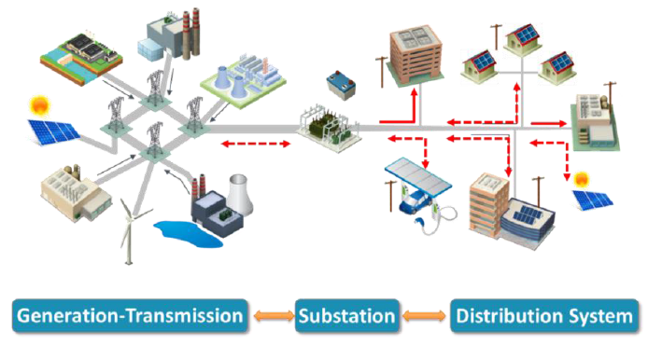
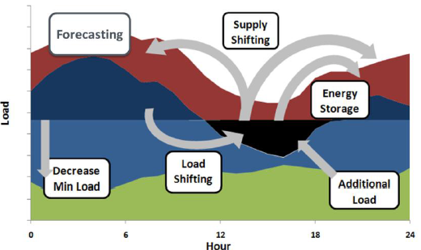
Detroit will be another kind of city modeled on the MK movement.
Each building will become an NRECA style
of semi-autonomous electric power fractal.
Notes:
In Detroit, the plan is to closely align the broadband infrastructure with the controls needed for the critical infrastructure. For resiliency, reliability, and security, each building will operate as a team member with other buildings and will eventually become its own “fractal” microgrid. The optimization of the building automation and the regulation of the electric power is a partnership between the utility and the building owners and is juggled every 2 seconds to shape the loads and thermal comfort. There are many other services planned to be offered by the same ecosystem orchestrator used in Milton Keynes.

Slide 7
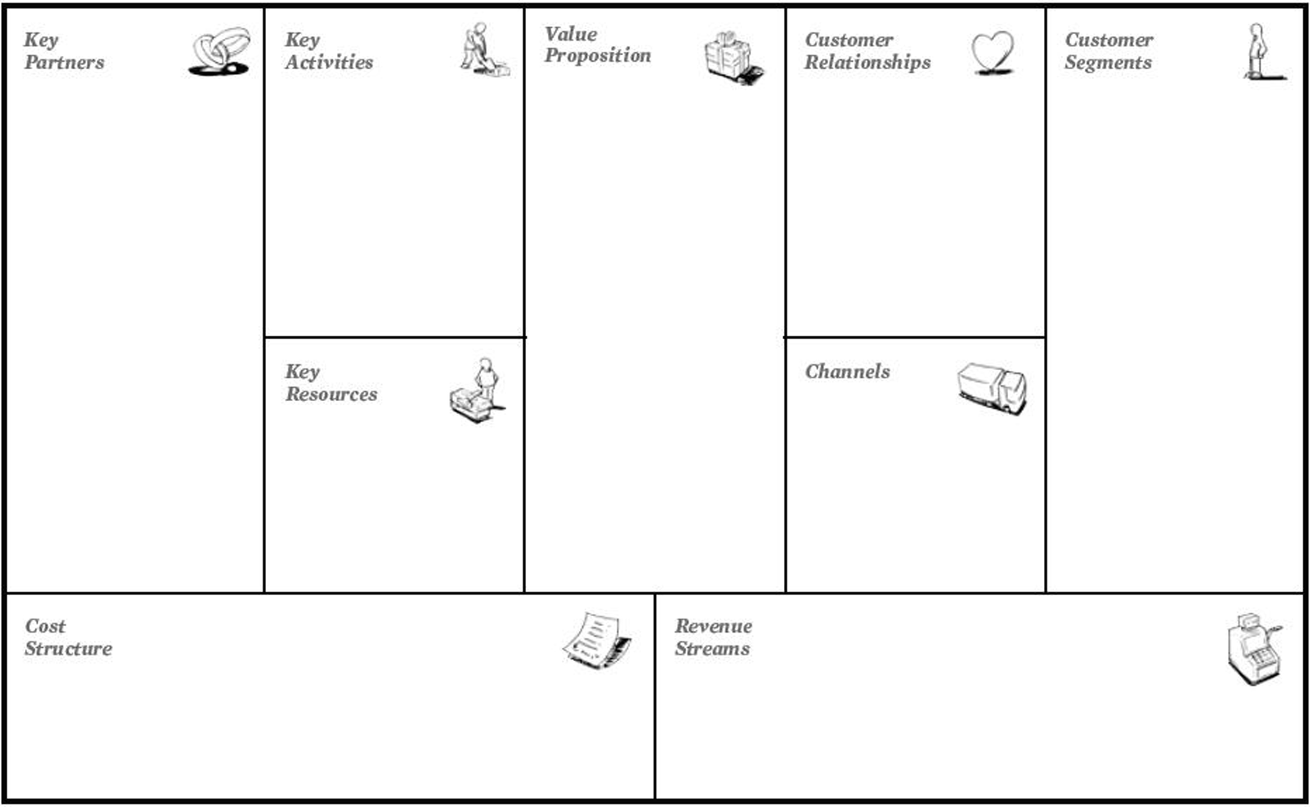
MK Data Hub Business Model Canvas
Platform operation
Research
Easy access to information and services
Self service
Residents
Local Council
Service management
Help desk
Easy monetization of own services
SME
Application Developers
Platform operations
Social media
Improvement of public services
Enterprises
Information Providers
“Real-time” information
Public Sector
Cloud Partner
Digital ecosystem management platform
Online Portal
Education
Public services companies
Reduction of energy and water usage
APIs
Utility companies
Sustainable City Growth
Call Centre
Infrastructure & platform operations
Information and Service usage
Recurring Costs
Support cost
Marketing
R&D costs
Set up fees
Grants & Sponsorship

Slide 8

Compliance with Strategic Initiatives and Standards of the TM Forum
B2B2X Business & Partnering Model
The business model of the MK Data Hub is documented using the business model canvas (previous slide). There are well-defined partnership component models (business model, contractual model, financial model, operational model).
For the MK Data Hub partnering model design see reference slides.
DSRA Architecture Blueprint
The MK Data Hub is designed to be deployed on BT’s Cloud Management platform (CMS) - this platform provides a comprehensive set of platform functions according to the DSRA: see reference slides.
APIs
The MK Data Hub is using REST API for internal and external interfaces. For connecting with other parties APIs are semantically aligned with the TM Forum API specification (for on-boarding, provisioning, mediation and billing)
Core Frameworx
eTOM: The MK Data Hub is leveraging the end-to-end processes of Infonova R6
SID: The MK Data Hub data model is implemented in R6 (for product and customer domain in particular) aligned with the SID
TAM: The MK Data Hub is built on a TAM compliant functional architecture

Slide 9
Reference SLIDES FOLLOW

Slide 10
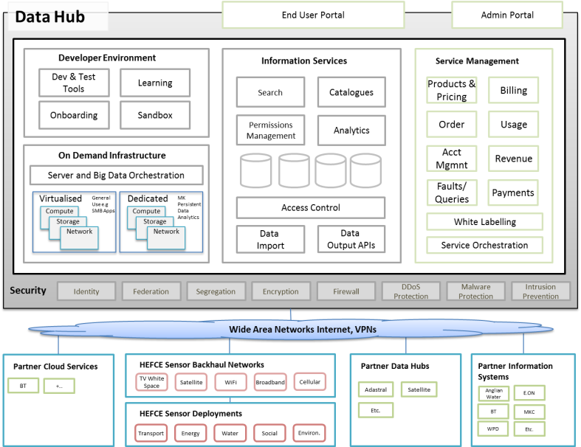
MK Data Hub Reference Architecture
SME
incubator

Slide 11
MK Data Hub Initial/Partial Partnering Model
Offer | Premium data feed “Keyne Eye”
 | Role Type |  | Provider
Partner 1 | Supplier service provider |  | Satellite Catapult
Relationship | Selling to ecosystem |  | Service Provider to the ecosystem via IS
Lifecycle stage types | Onboarding | Adding Value |  | Delivery
 | Internal: done by the service provider | Configuration: setting characteristics that differentiate the service; Branding/Co-branding: applying a trusted or popular brand to increase appeal; Packaging/Bundling: combining a service with others to improve value provided to customer; Mashup: combines management and functional interfaces; Commercialization: providing access to a market that is otherwise unavailable to a supplier |  | Syndication: deliver indirectly to a customer through one or more other digital service providers
 | Role Type |  | Provider
Partner 2 | Content |  | MK council
Relationship | Providing/contribute planning data to the ecosystem; Sell-through |  | Content Provider
Lifecycle stage types | Onboarding | Adding Value |  | Delivery
 | Internal: done by the service provider | Mashup: combines management and functional interfaces |  | Syndication: deliver indirectly to a customer through one or more other digital service providers
 | Role Type |  | Provider
Partner 3+ | Satellite data providers |  | Various companies
Relationship | Sell-through |  | Content Provider
Lifecycle stage types | Onboarding | Adding Value |  | Delivery
 | Internal: done by the service provider | Mashup: combines management and functional interfaces |  | Syndication: deliver indirectly to a customer through one or more other digital service providers

Slide 12
Mapping MK Data Hub to the DSRA Platform Services
Platform Service Name | In scope (Y/N) | Comment
Federated Identity Mgmt | Y | The MK Data Hub is using JSIG CAS as single-sign-on framework. Identity management can be federated across the ecosystem.
Federated Profile Mgmt | P | The Infonova R6 user management is used for the MK Data Hub. Federation of user profile management will be supported in future.
Analytics | Y | Data analytics is used by service providers and the IS platform itself
Discovery | N | Planned for the future
Configuration & Activation | Y | The MK Data Hub is using the Infonova R6 order management and provisioning component. Services within the ecosystems can be configured and activated using the portal or REST API.
Assurance & Traceability | Y | For service assurance (incl. monitoring) the Cloudsoft AMP platform is used.
Charging | Y | All service usage is rated and charged by the Infonova R6 rating module – either for charging within the VSP component for wholesale charging or on VSO level for retail charging.
Invoicing | Y | Invoices are generated by the Infonova R6 billing component – The MK Data Hub supports wholesale and retail billing
Catalog Lifecycle Mgmt & Federation | Y | The MK Data Hub uses the R6 product catalogue for wholesale and retail product management.
Onboarding | Y | The MK Data Hub uses the R6 REST API to on-board new services. On-boarding of partners and tenants (VSOs) will be supported in the future

Slide 13

Milton Keynes: Statistics
Facts about growth in Milton Keynes (2004-2013)
Highest population growth (16.5%)
Highest job increase (18.2%)
Highest growth in number of homes (16.4%)
2nd highest percentage of start-ups (after London)
Source: Cities Outlook 2015

Slide 14









Partners
“Today’s economic map of the world is dominated by what I call clusters:
critical masses – in one place – of unusual competitive success in one field”
Michael Porter

