Slide 1



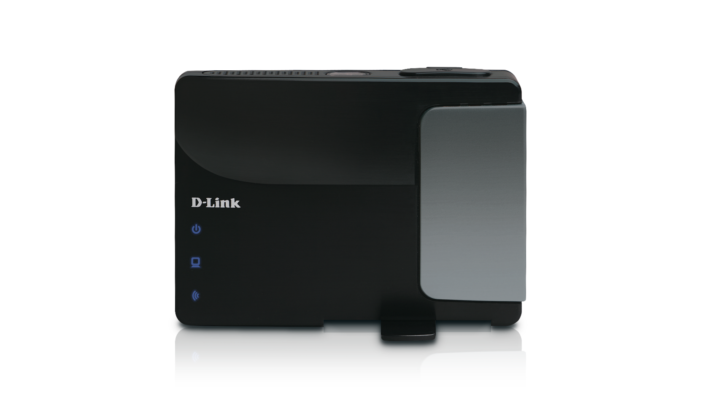







1
Powered By Telflow
2
PRODUCT MANAGER
Service Provider
SELF SERVICE CUSTOMER
DESIGN TIME / BUNDLING LAYER
SELF SERVICE PORTAL / B2B
RUN TIME / ORCHESTRATION LAYER
B2B2X Best Practice
ebXML
TMF Active Catalogue PSA
SOAP
TMF Open Digital API
REST
1
2
3
4
FIBRE ACCESS
(LAYER 2)
VIRTUAL NETWORK
VIRTUAL FIREWALL
SASS + IAAS CLUSTER
Virtual IT Bundle

Slide 2
Service Bundling in a b2b2X Marketplace
Service Provider
Powered By Telflow
DESIGN TIME / BUNDLING LAYER
PRODUCT MANAGER
SELF SERVICE PORTAL
RUN TIME / ORCHESTRATION LAYER
B2B2X Best Practice - ebXML
TMF Active Catalogue PSA - SOAP
TMF Open Digital APIs - REST
1
2
3
4
5
FIBRE ACCESS
(LAYER 2)
VIRTUAL NETWORK
VIRTUAL FIREWALL
IAAS
CLUSTER
ERP SASS INSTALLTION
SELF SERVICE CUSTOMER
Virtual IT Bundle: Built from Multiple suppliers

Slide 3
b2b2X Service Bundling – Development Roadmap
Delivered in PSA or Telflow CIM
Mon
Tues
Wed
Thurs
Fri
Sat
Sun
28
29
30
1
2
3
4
Final Day for Specifications
Catalyst Development (Framework + Stubs)
5
6
7
8
9
10
11
Catalyst Development (Framework + Stubs)
Endpoints + Credentials
Integration Cutoff Point
12
13
14
15
16
17
18
Catalyst Development (Integration & Finalisation)
Integration Fallback Point
Development Complete
19
20
21
22
23
24
25
Fallback to Stubs
DGIT LEAD E2E Testing
Testing Complete
26
27
28
29
30
31
1

Slide 4
Service Bundling in a b2b2X Marketplace
Booth Signage
PORT + SPEED PROFILE
Key Points
- Multi Provider: Service bundling/composition across enterprises
- Instant Services: Dynamic service bundling configured at run-time
- Instant E2E Management of bundled services: Provision & Operation
Frameworx Foundations
B2B2X Best Practice GB 981/982
Information Framework (SID) Models GB922
Product service and resource models
Open Digital REST based APIs: ordering, catalog
Integration with TM Forum Active catalog PSA TMF 867
Demonstration
- Bundled Fibre Access, XaaS and NFV services
APPLICATIONS + NAME
CPU, DISK, RAM, NODES
INTERFACE + VLAN ID
SRC. + DEST. SOCKETS
INTERFACE + VLAN ID?

Slide 5
Service Bundling in a b2b2X Marketplace
Working Slide Pack: Solution Overview, Parameters for E2E Service Mapping, Booth Text & Delivery Roadmap

Slide 6

Service Bundling in a b2b2X Marketplace
Solution Overview
Service Provider
Powered By
DESIGN TIME / BUNDLING LAYER
PRODUCT MANAGER
SELF SERVICE PORTAL
RUN TIME / ORCHESTRATION LAYER
B2B2X Best Practice - ebXML
TMF Active Catalogue PSA - SOAP
TMF Open Digital APIs - REST
1
2
3
4
5
FIBRE ACCESS
(LAYER 2)
VIRTUAL NETWORK
VIRTUAL FIREWALL
IAAS
CLUSTER
ERP SASS INSTALLATION
SELF SERVICE CUSTOMER
Virtual IT Bundle: Built from Multiple suppliers

Slide 7
Service Bundling in a b2b2X Marketplace
E2E Service Connectivity
In order to deliver a coherent E2E service, service specifications must accept parameters which allow interworking with adjacent services. This diagram captures a minimum set of parameters (shown in the blue boxes) to facilitate E2E connectivity.
Service Linking Parameters
Adjacent Specifications need to include these in order to link services together
Interface
(Port + VLAN)
Virtual Network NAME
Speed Profile, PORT ID, VLAN ID
Interface, VLAN ID
Source + Destination Sockets
CPU, DISK, RAM,
& VIRTUAL NETWORK Name
Applications + Name
General Parameters
For Example
FIBRE ACCESS
(LAYER 2)
VIRTUAL NETWORK
VIRTUAL FIREWALL
IAAS
CLUSTER
ERP SASS INSTALLTION

Slide 8
Service Bundling in a b2b2X Marketplace
Demonstration Storyboard
SELF SERVICE CUSTOMER
Sign In
Perform NBNCo
Address qualification
Select TNHS 8, 245 Smith St Manly NSW Address
Choose
VIRTUAL IT Bundle Product
Complete NEW Order for
VIRTUAL IT Bundle
VIRTUAL IT Bundle
Select Existing Resources via external rules:
NNI / Handover Interface
Virtual Network (By Customer)
Create All new Entities:
NBN CO NFAS
Virtual Network
Virtual Firewall
Iaas
SaaS
View B2B Messages to Suppliers
X1 or x3
Load S/P Order & Select B2B Tab
Observe Order decomposition
Review Order & Select Fulfilment Tab
Navigate to customer order
Navigate Partner Systems
Show completed partner transactions
Show completed Product Order & Inventory
End
Determine storyboard for partner systems
Virtual IT Bundle
Layer 2 Biststream
Virtual Network
ERP SASS
NBN Co NFAS
?
IaaS
SaaS
Router Here?

Slide 9
Service Bundling in a b2b2X Marketplace
Booth Text (WIP)
Key Points
- Multi Provider: Service bundling/composition across enterprises
- Instant Services: Dynamic service bundling configured at run-time
- Instant E2E Management of bundled services: Provision & Operation
Frameworx Foundations
B2B2X Best Practice GB 981/982
Information Framework (SID) Models GB922
Product service and resource models
Open Digital REST based APIs: ordering, catalog
Integration with TM Forum Active catalog PSA TMF 867
Demonstration
- Bundled Fibre Access, XaaS and NFV services

Slide 10
Service Bundling in a b2b2X Marketplace
Development Roadmap
Delivered in PSA or Telflow CIM
Mon
Tues
Wed
Thurs
Fri
Sat
Sun
28
29
30
1
2
3
4
Final Day for Specifications
Catalyst Development (Framework + Stubs)
5
6
7
8
9
10
11
Catalyst Development (Framework + Stubs)
Endpoints + Credentials
Integration Cutoff Point
12
13
14
15
16
17
18
Catalyst Development (Integration & Finalisation)
Integration Fallback Point
Development Complete
19
20
21
22
23
24
25
Fallback to Stubs
DGIT Lead E2E Testing
Testing Complete
26
27
28
29
30
31
1

